Slide 1

COMPREHENSIVE DIGITAL MARKETING HDFC BANK

Slide 2
PRESENTATION BY: Team Leader : DATLA SRAVYA Team member : CHOWDARY PREMVIVEK Team member : BATTINA VENKATAVINAYAKATARUNKUMAR Team member : BISWANATH MANNA Team member : BANTUPALLI SAI VENKAT TEJA

Slide 3
INTRODUCTION
Title: HDFC Bank Brand Study for Digital Marketing
Brief Overview: Introduce HDFC Bank as one of India's leading private sector banks with a strong presence in the digital market. Highlight the bank's commitment to providing innovative financial solutions to its customers.

Slide 4
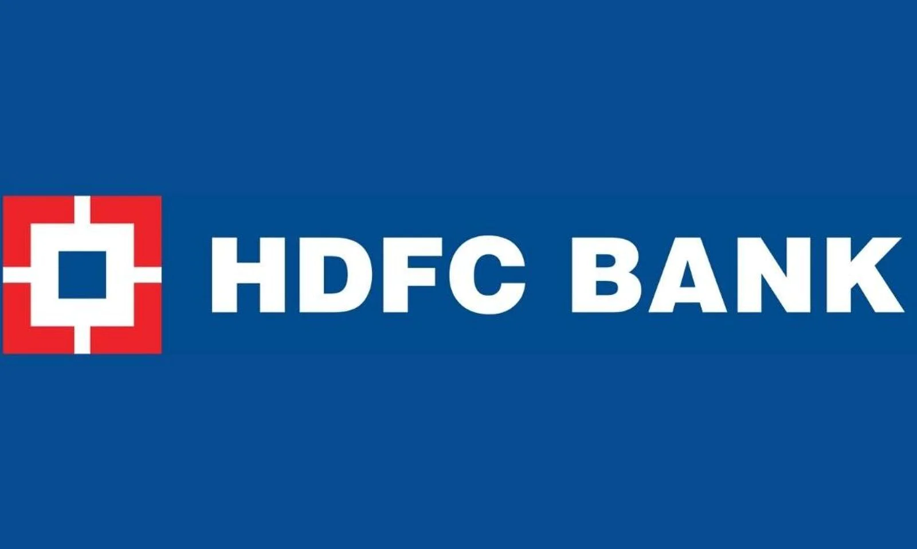

Slide 5
BRAND STUDY
Vision: To be the most preferred and globally admired financial services provider.
Mission: To be the best provider of financial services for creating lasting customer value and shareholder wealth.
Brand Values: Trust, Transparency, Innovation, Customer Centricity.
Unique Selling Proposition (USP): Seamless Digital Banking Experience, Wide Range of Products, and Award-Winning Customer Service.

Slide 6
COMPETITOR ANALYSIS
Main Competitors: State Bank of India, ICICI Bank, Axis Bank, Kotak Mahindra Bank, and others.
Points of Differentiation: Highlight HDFC Bank's strengths compared to competitors, such as a more user-friendly mobile app, personalized product offerings, and a larger network of ATMs and branches.
Market Share: Present HDFC Bank's market share in the

Slide 7
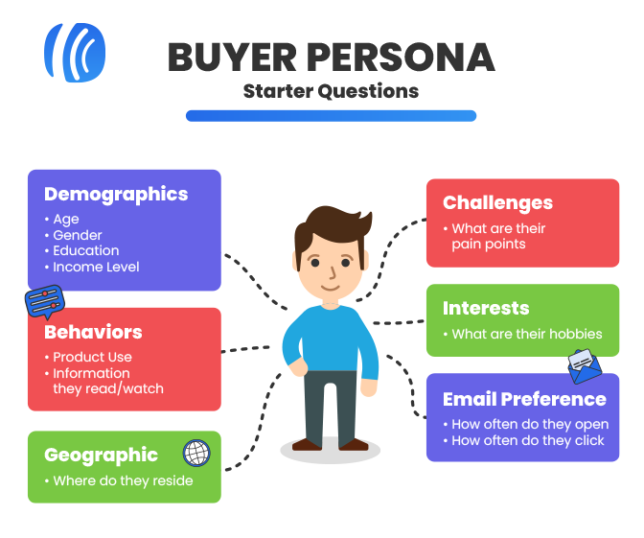
BUYER/AUDIENCE PERSONA
Demographics: Age, Gender, Location, Income Level.
Behavior: Tech-savvy, Prefer Convenience, Regular Internet Users.
Needs: Easy Access to Banking Services, Digital Payment Solutions, Personalized Financial Advice.
Pain Points: Security Concerns, Complex Banking Processes, Lack of Transparency.

Slide 8
DIGITAL MARKETING STRATEGY
Targeting: Focus on tech-savvy individuals aged 25-40 in urban and semi-urban areas.
Channels: Utilize Social Media (Facebook, Instagram, Twitter) for engagement and brand awareness. Email marketing for personalized offers and updates. Google Ads for reaching potential customers actively searching for banking services.
Content Strategy: Create informative and engaging content on financial planning, investment tips, and the benefits of digital banking.
Measurement: Track website traffic, engagement, conversion rates, and customer feedback to measure the success of the digital marketing campaigns.

Slide 9
PART-2 SEO AND KEYWORD RESEARCH

Slide 10
INTRODUCTION
Title: SEO and Keyword Research for HDFC Bank's Digital Marketing
Brief Overview: Explain the importance of SEO and keyword research in digital marketing. Highlight how strategic keyword optimization can improve HDFC Bank's online visibility and attract relevant traffic.
Search Engine Optimization (SEO) is a crucial aspect of digital marketing that focuses on optimizing a website to rank higher in search engine results. By utilizing effective keyword research, HDFC Bank can enhance its online presence and reach potential customers actively searching for banking services.

Slide 11
KEYWORD RESEARCH TOOLS
Explain the significance of keyword research tools in identifying relevant keywords for HDFC Bank's digital marketing campaigns.
Google Keyword Planner: This free tool by Google allows marketers to discover relevant keywords and their search volumes. For example, by entering "credit card," HDFC Bank can find related keywords like "best credit card offers," "credit card rewards," and their respective search volumes. This helps prioritize high-traffic keywords.
SEMrush: A comprehensive SEO tool that not only identifies keywords but also provides insights into competitors' organic and paid search strategies. HDFC Bank can analyze which keywords its competitors are ranking for and adjust its strategy accordingly.
Ahrefs: A powerful SEO tool that offers keyword analysis, backlink data, and competitor research. With Ahrefs, HDFC Bank can identify valuable keywords that its competitors might be overlooking and leverage them for improved search rankings.

Slide 12
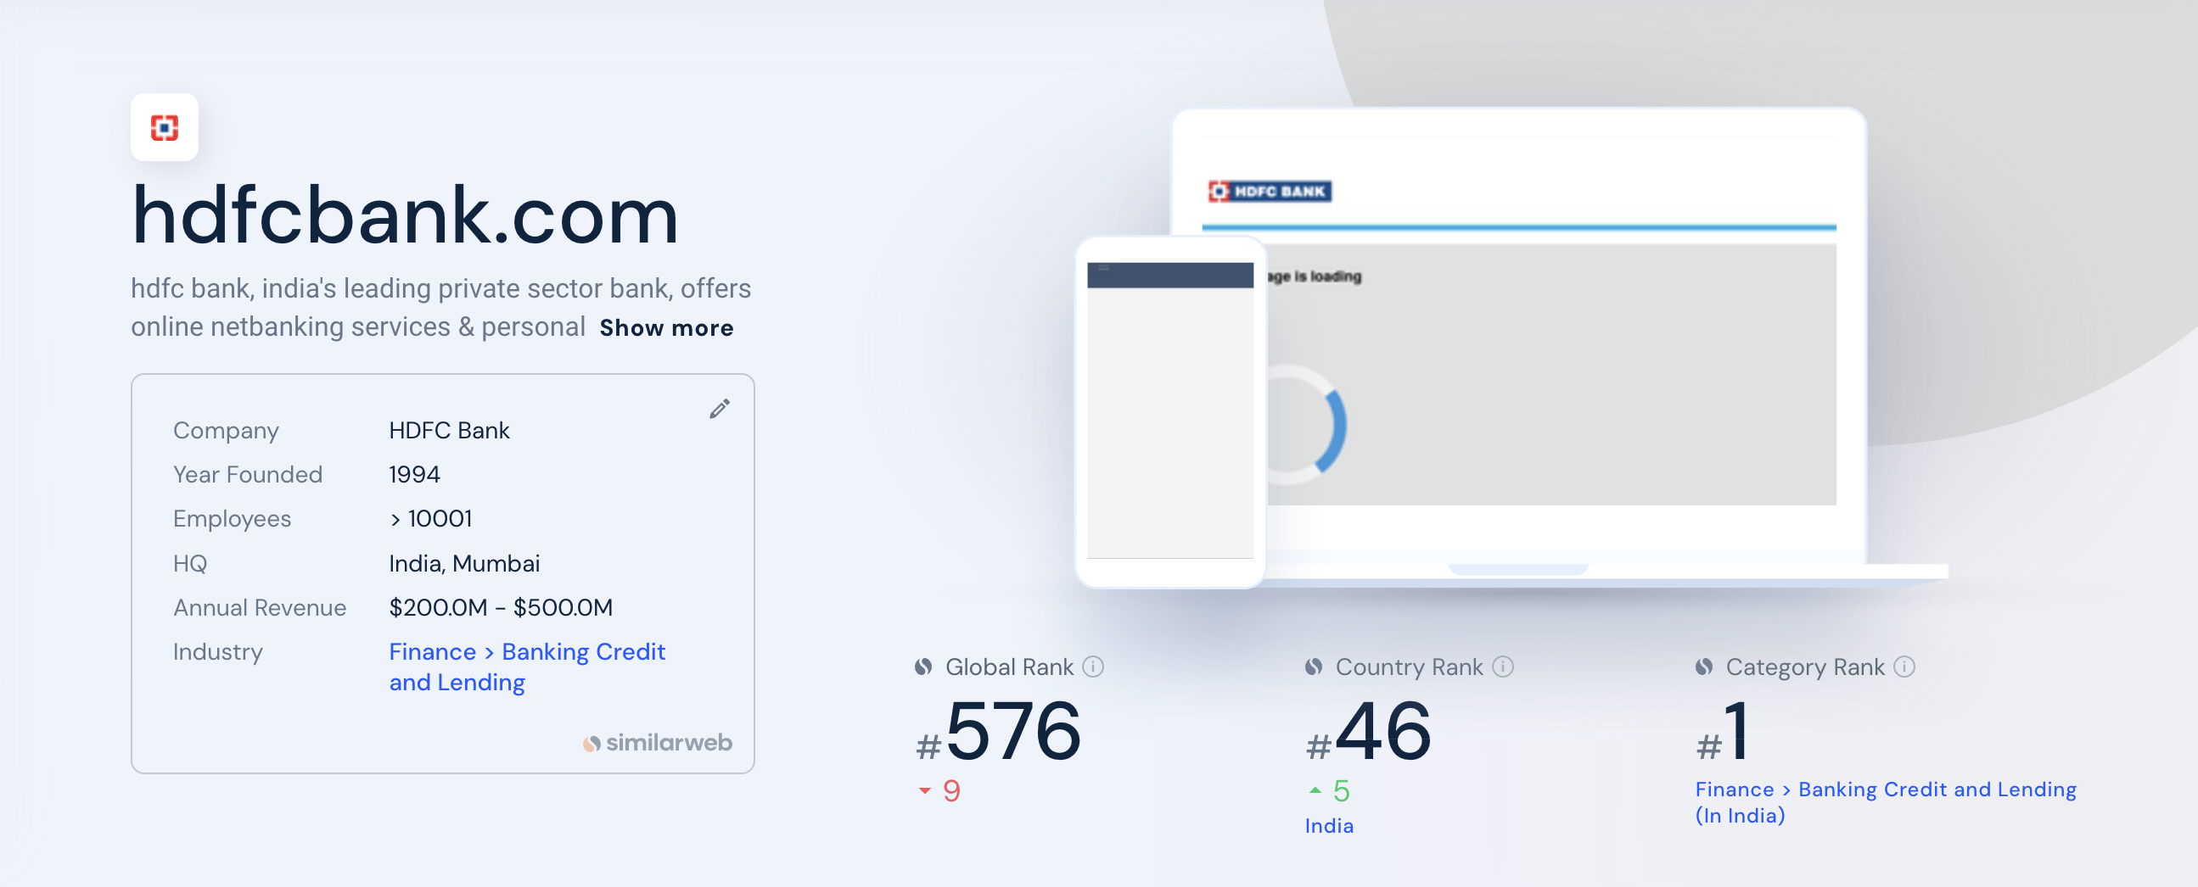

Slide 13
ANALYSIS OF COMPETITOR KEYWORDS
Emphasize the importance of analyzing competitor keywords to gain a competitive edge.
Identify Main Competitors: Analyze key competitors in the banking sector, such as State Bank of India, ICICI Bank, Axis Bank, and others.
Keyword Gap Analysis: Conduct a keyword gap analysis to identify keywords that competitors are ranking for, but HDFC Bank is not. For instance, if a competitor is ranking for "best home loans," but HDFC Bank is not targeting this keyword, it presents an opportunity to optimize content around this term.
Competitive Keyword Benchmarking: Compare HDFC Bank's current keyword rankings with those of its competitors. Identify areas where HDFC Bank's ranking is weaker and develop strategies to improve those rankings.

Slide 14
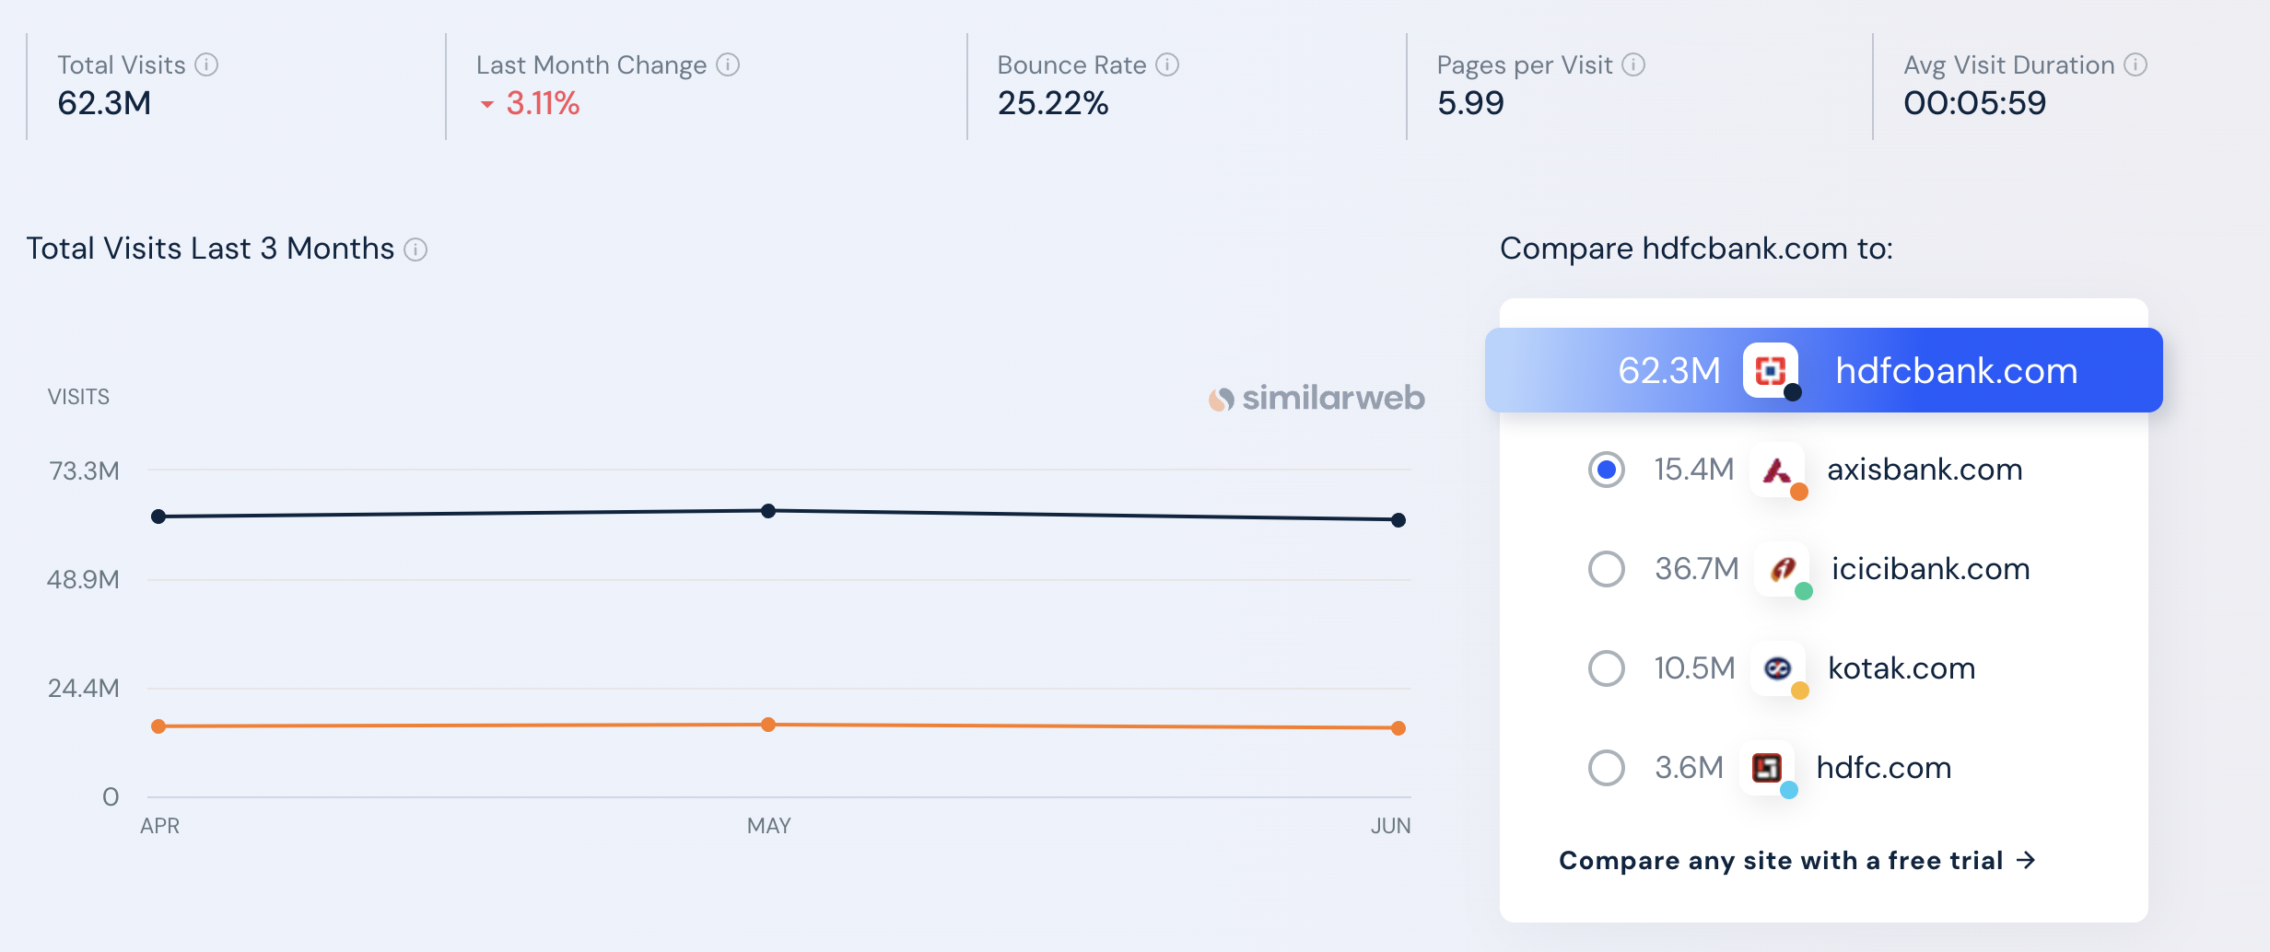

Slide 15
LONG TAIL KEYWORDS
Define long tail keywords and their relevance in SEO.
Long Tail Keywords: Long tail keywords are more specific and less commonly searched phrases that target a niche audience. For example, "low-interest rate home loans for first-time buyers" is a long tail keyword.
Relevance: Long tail keywords attract highly targeted and qualified traffic. Users searching for specific terms are often closer to making a decision, making them valuable prospects for HDFC Bank.
Example: Instead of targeting the broad keyword "credit cards," HDFC Bank can also focus on long tail variations like "travel rewards credit cards" or "cashback credit cards for online shopping."

Slide 16
KEYWORD IMPLEMENTATION
Highlight the strategic implementation of researched keywords across HDFC Bank's website and digital content.
On-Page SEO: Integrate researched keywords into website meta tags, headings, and content. For instance, optimize the meta title and description of the homepage with high-priority keywords like "HDFC Bank - Best Banking Services in India."
Content Optimization: Create high-quality, informative content around target keywords. For example, publish articles on "Tips for Financial Planning" or "How to Choose the Right Savings Account."
URL Structure: Use keywords in URL structures for improved search engine visibility. For example, a well-structured URL like "hdfcbank.com/home-loans" is more SEO-friendly than "hdfcbank.com/19284xh."

Slide 17
SEO MONITORING AND OPTIMIZATION
Discuss the need for continuous monitoring and optimization of SEO efforts.
Rank Tracking: Use tools like SEMrush or Ahrefs to track keyword rankings regularly. Monitor changes in rankings and identify opportunities for improvement.
Analytics and User Behavior: Analyze website traffic, user engagement, and conversion rates. Observe user behavior to understand which keywords drive the most valuable traffic.
Iterative Approach: Continuously refine keyword strategy based on performance data. Adapt to changing search trends and customer behavior to maintain a competitive edge.

Slide 18
META TAG OPTIMIZATION
Meta tags are HTML tags used to provide additional information about a page to search engines and other clients. Clients process the meta tags and ignore those they don’t support. Meta tags are added to the <head> section of your HTML page and generally look like this: <!
Meta Description for SEO:
Keep it under 160 characters.
Create distinct summaries for each page.
Avoid duplicate meta descriptions on your website.
Use sentence case.
Be accurate, descriptive, and concise.
Match search content.
Only include your target keyword where it makes sense.

Slide 19
CONTENT OPTIMIZATION FOR SEO
Essentially content optimization, or SEO (search engine optimization) is the process of optimizing your content to make sure that it’s more visible through the web. Search engine robots will rank highly optimized content higher on a search engine page than non-optimized content.
Tips and techniques how to optimize:
Write great content
Keep new content coming
Use headings
Optimize the text
Optimise images
Optimise videos
Stop writing for search engines
Use social media
Keep it clean

Slide 20
PROCESS OF CONDUCTING KEYWORD RESEARCH AND THE SEO RECOMMENDATIONS
Keyword research is the process of finding and analysing keywords your ideal website visitors enter into search engines that enables you to target the most effective keywords in your content strategy. Keywords are words or phrases people use to find information or products in search engines. For example, if you want to buy food for your puppy you might type the keyword food for puppies into google properly conducted keyword helps you to:
Better understand your niche and target audience.
Tailor your content strategy to the needs of your audience.
Get more relevant traffic to your website.

Slide 21
IN THIS GUIDE, WE’LL COVER THREE STEPS OF KEYWORD RESEARCH
Finding keywords: How to find relevant keywords with keyword research tools.
Analysing keywords: How to prioritize keywords using key metrics and criteria.
Targeting keywords: How to identify primary keywords and nail their search intent.

Slide 22
Challenges faced during the research and analysis phase, as well as the key insights gained from the keyword research process.
What is Keyword Research?
Keyword research is the process of identifying which queries customers use to guide their search journey and lead them to relevant information.
To help, Google provides a free tool called the Google Keyword Planner for Google AdWords users that assigns a monthly search volume estimate for keyword phrases (groups of keywords clustered together) to help researchers. It also provides keyword suggestions to find more potential targets.
But SEO clarity users can review the largest keyword data set available: 30+ billion keywords across +170 countries, and updated weekly!

Slide 23
WHY IS KEYWORD RESEARCH IMPORTANT?
Keyword research allows you to discover terms related to a certain topic and uncover their search demand, difficulty score, intent and more.
From there, you can create content based on those words and topics, and get in front of your target audience by appearing on the Google search engine results pages (SERPs) with the content you know they’re looking for.
You can’t create content on a whim and hope that it performs well – you need to create data-supported content that you know will perform properly for the right target audience.
This is where keyword analysis goes hand-in-hand with research.

Slide 24
WHY WE RESEARCH AND ANAYLZE KEYWORDS?
A. Prioritize keyword opportunities. Not all phrases you discover during the research can, in fact, drive significant traffic or rankings. Or their popularity is seasonal and there is no need to work on them now. Keyword analysis allows you to prioritize opportunities so that you always work on the ones that can deliver the highest ROI.
B. Learn more about the audience's preferences. Analyzing keyword data like the search volume or CPC cost will reveal a lot about what engages the audience. You will also discover which keywords are the most relevant to your audience (and why).
C. Evaluate the competition. Keyword analysis uncovers who else targets the keywords, and how likely you are to beat them (or what you need to do in order to beat them).
D. Analyze current keywords' performance. The process will also reveal the reasons why certain pages do not perform well for their target keywords, and highlight ways to overcome the issue.

Slide 25
HOW TO DO KEYWORD RESEARCH AS PART OF YOUR SEO STRATEGY
Now that I've outlined the need-to-know concepts above, we can dive into the details of how to actually conduct your research.
The processes I've outlined below are ones I use personally and recommend to our clients. It will help you identify head terms to target, long-tail keywords to drive targeted traffic and create the content that will help you achieve your goals.
Our process includes five, easy-to-follow steps:
Identify the most relevant topics.
Match topics with seed keywords (or head terms).
Research more deeply in line with your core topics.
Refine those keywords to identify the biggest opportunities.
Prioritize keywords to focus on first.

Slide 26
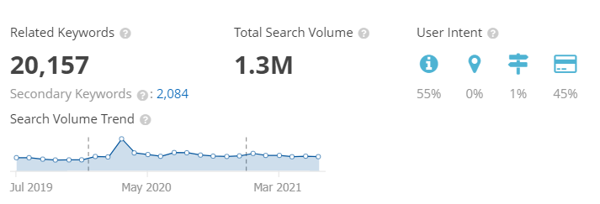

Slide 27
Strategy, Aim and the Idea behind these posts and stories
Ensures consistency: Content calendar lays out all your marketing activities including past, present and future, so you can better see how each activity relates to the others. This feature allows you to plan a more consistent schedule of activities – and make sure that they all work together to build your brand.
A content calendar is a resource to plan, schedule, and organize content creation and publishing. Marketing teams rely on their content calendars to plan campaigns across different platforms—like the company's blog, email marketing, and social networks.
A content calendar is important to keep your content marketing well-organized and on track. It helps you with initial brainstorming, which saves you from last-minute disastrous planning and helps you produce content consistently.
A social media calendar lets you plan ahead, batch your work, avoid multitasking, and note down all your content ideas for later. Social media planning calendar tools even allow you to schedule social media posts ahead of time

Slide 28
Content, Ideas & Marketing strategies process
Adopt a unique angle with your content. Know Your Audience.
Tap into current trends.
Build evergreen content.
Nurture your email subscribers.
Create original research.
Write your case studies.
Build Interactive Tools.

Slide 29
Testimonials and Reviews.
Repurpose content.
Update old content.
Encourage user-generated content.
Guest Blogging.
Create videos on social media.
Host a podcast.
Offer lead magnets in exchange for email.

Slide 30
Challenges encountered and lessons learned in marketing strategies
Recruiting talent.
Maintaining a sufficient budget.
Generating leads. ...
Finding the right tools.
Being risk-averse.
Moving into new markets.
Retaining customers.
Retaining and training staff.
Choosing effective tactics.
Facing increased competition.

Slide 31
PART-3 CONTENT CREATION AND CURATION

Slide 32
INTRODUCTION
Title: Content Creation and Curation for HDFC Bank's Digital Marketing
Brief Overview: Explain the significance of content creation and curation in HDFC Bank's digital marketing strategy. Emphasize how engaging and relevant content can attract and retain customers in the competitive banking industry.

Slide 33
CONTENT CREATION STRATEGIES
High-Quality Content: Produce informative and valuable content that addresses the needs and pain points of the target audience.
Content Calendar: Implement a content calendar to plan and organize content creation, ensuring consistency and timely delivery.
Visual Content: Incorporate visual elements like infographics, images, and videos to enhance engagement and comprehension.
SEO Integration: Integrate targeted keywords into the content to improve search engine visibility and organic traffic.

Slide 34
Content ideas and marketing strategies
Content calendar of JULY month : HDFC Bank
Sunday | Monday | Tuesday | Wednesday | Thursday | Friday | Saturday
 |  |  |  |  |  | 01.Welcome July Shared a post on Instagram.
02. | 03. Financial tips Monday | 04. | 05. Share the bank's commitment to sustainability for a greener future. | 06. | 07.Posted a story (quiz) on Instagram https://instagram.com/hdfc.bank999?utm_source=qr&igshid=ZDc4ODBmNjlmNQ%3D%3D | 08. Best Investment Options - Educate the audience about various investment
09. | 10.Bloghttps://www.hdfcbank.com/personal/resources/learning-centre/pay/what-are-the-benefits-of-a-credit-card | 11. | 12. #Travel wednesday - Share travel tips and information about Axis Bank's travel-friendly financial services. | 13. | 14. Fun Fact Friday - Share another intriguing fact to keep the audience engaged. | 15.
16. | 17. | 18. | 19. | 20. Promotion video | 21. | 22.
23. | 24. | 25. | 26. | 27. | 28. | 29.
30. Recap the highlights on the month. | 31.

Slide 35
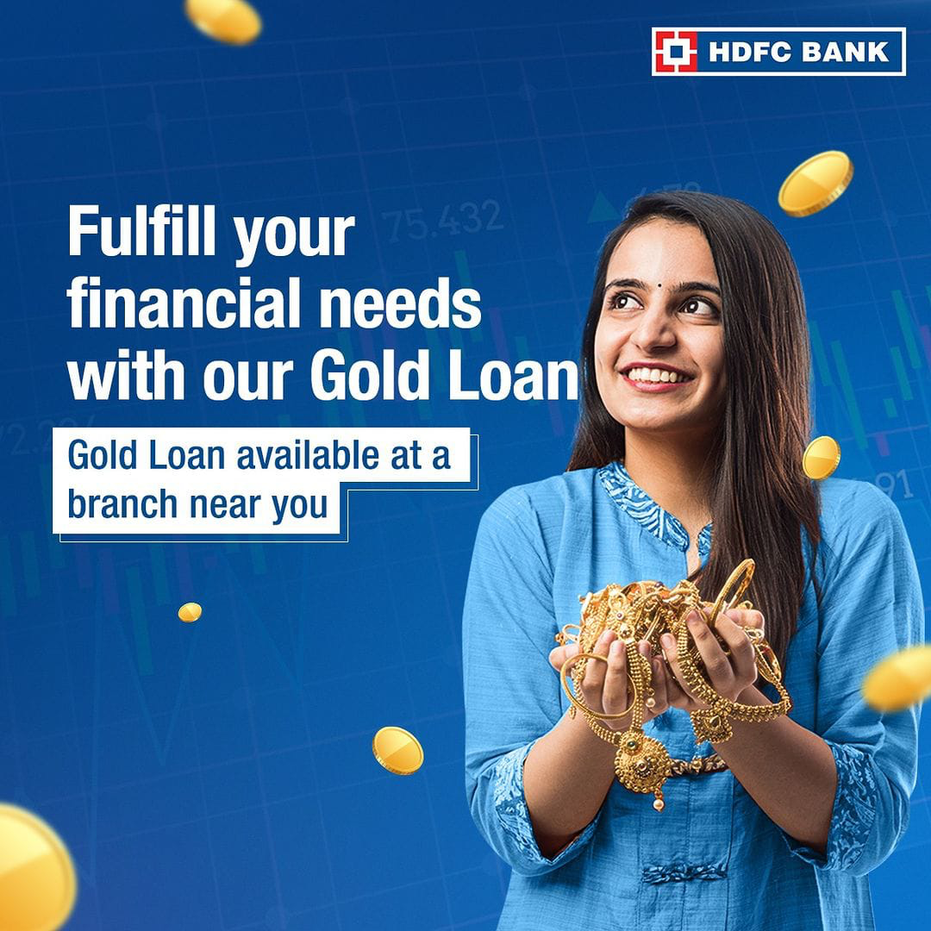


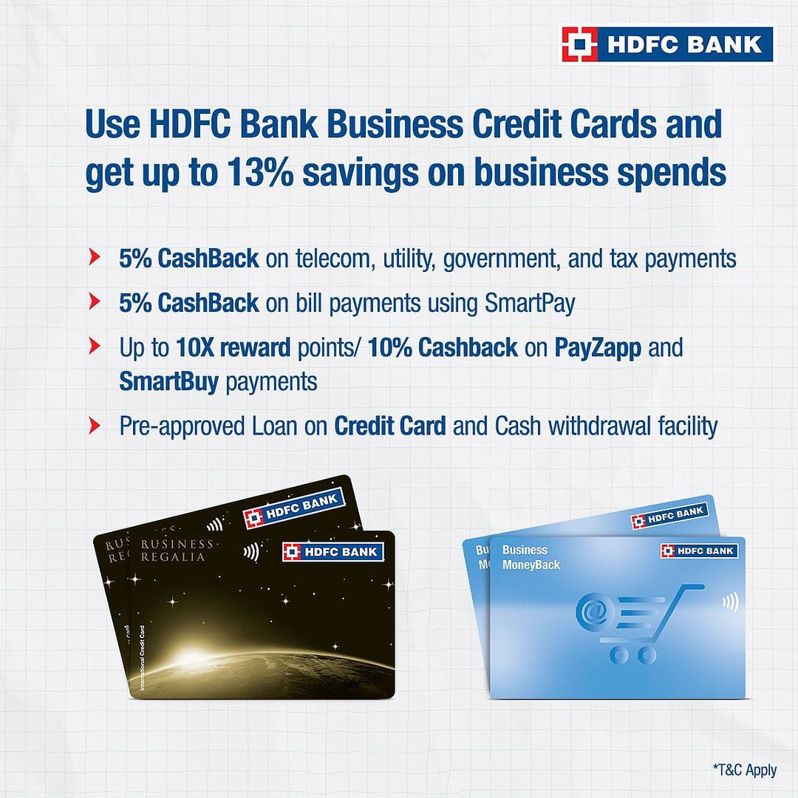

Slide 36
CONTENT CURATION STRATEGIES
Define Content Curation: Explain the practice of gathering and sharing relevant content from external sources to add value to the audience.
Credibility and Trust: Curate content from reputable sources to establish credibility and trust with the audience.
Diverse Content: Curate a mix of articles, industry news, and expert insights to provide a comprehensive view of financial topics.
Personalization: Tailor curated content to match the preferences and interests of the target audience.

Slide 37
SOCIAL MEDIA CAMPAIGNS
Utilize Social Platforms: Identify key social media platforms (e.g., Facebook, Twitter, LinkedIn, Instagram) to reach a wide range of audience segments.
Engaging Visuals: Use eye-catching visuals, interactive content, and storytelling techniques to capture and retain audience attention.
Call-to-Action (CTA): Include clear and compelling CTAs in social media posts to encourage audience interaction and conversion.
Analytics and Insights: Monitor social media metrics to measure the effectiveness of campaigns and make data-driven improvements.

Slide 38
Format 1 : Blog article (https://www.hdfcbank.com/personal/resources/learning-centre/pay/what-are-the-benefits-of-a-credit-card).
Aim : To promote activation of credit card for customers.
Date : 10th July
Idea : Credit card activation helps in preventing fraudulent activities. The cardholder can use the credit card for purchasing purposes as soon as he/she activates it.
Topic : Why to keep our credit card active ?
Note* : For more details click on the link.
Format 2 : Video . https://drive.google.com/file/d/12IDLLwWzaKExz7j-a3Kzc1up4jHJuBoM/view?usp=drivesdk
Aim : To promote our brand to the public.
Date: 20th July
Idea : introduce your brand, talk about your purpose and goals, and solve pain points.
Topic : Giving a clear explanation of axis bank through a video.
Format 3 : Creative (https://instagram.com/hdfc.bank999?utm_source=qr&igshid=ZDc4ODBmNjlmNQ%3D%3D)
Aim : To increase public audience.
Date : 1st August
Idea : promoting the brand name and about brand through the post on Instagram.
Topic : Posting of brand logo and identity on social media.

Slide 39
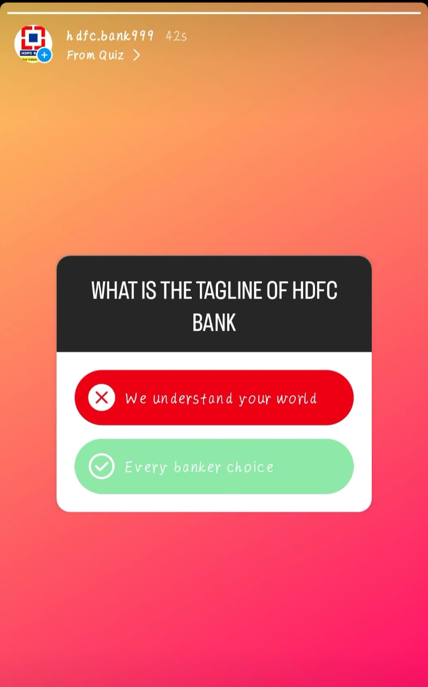
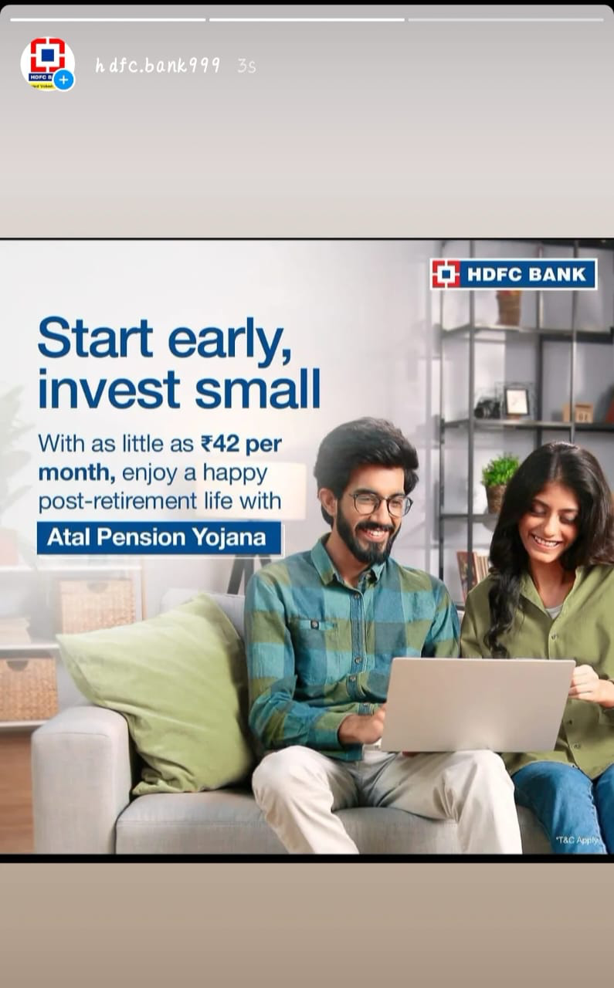
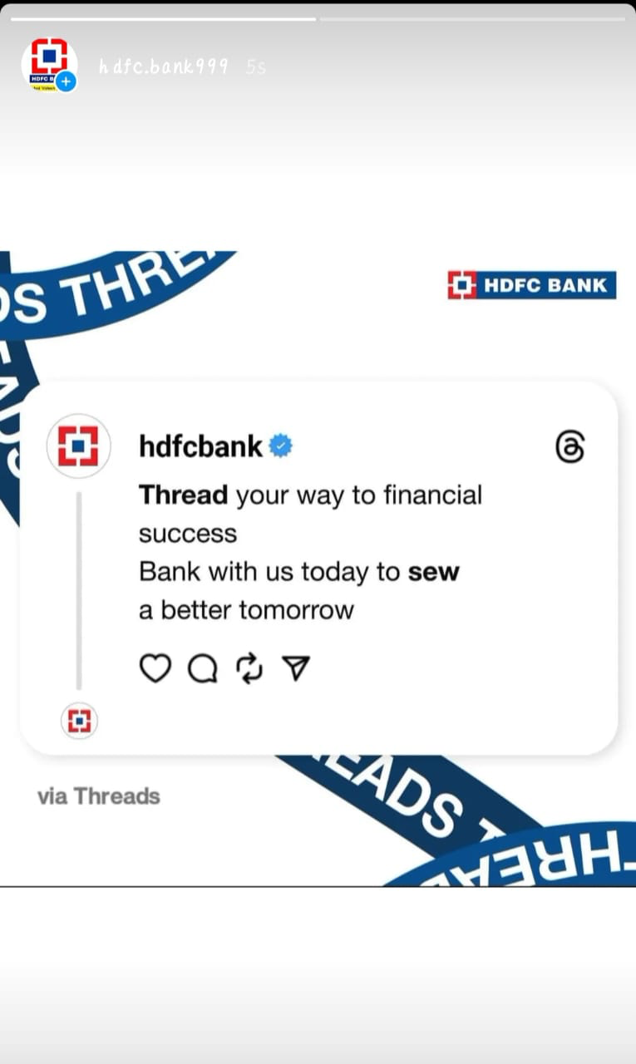
Instagram stories

Slide 40

INSTAGRAM POSTS
https://www.instagram.com/reel/Cvd7SEGgJ54/?igshid=MzRlODBiNWFlZA==

Slide 41
ADVERTISING GOALS
Brand Awareness: Increase HDFC Bank's brand visibility and recognition among the target audience.
Lead Generation: Generate qualified leads for various banking products and services through targeted advertising campaigns.
Conversion: Drive conversions, such as credit card applications, loan inquiries, and account openings, through optimized landing pages and ads.
Retention: Engage existing customers through personalized offers and promotions to foster loyalty and retention.

Slide 42
AUDIENCE TARGETING
Demographics: Identify the target audience based on age, gender, location, income level, and other relevant demographics.
Behavior: Analyze online behavior and preferences to understand customer interests and tailor content accordingly.
Personalization: Implement personalized content recommendations based on user interactions and previous engagement.
A/B Testing: Conduct A/B testing of different content variations to identify the most effective messaging for different audience segments.

Slide 43
AREAS OF IMPROVEMENT
Content Relevance: Continuously evaluate content to ensure it remains relevant and aligned with customer needs.
Data Privacy: Address data privacy concerns and ensure compliance with data protection regulations while using customer data for personalization.
Social Listening: Engage in social listening to understand customer sentiment and address any negative feedback promptly.
Performance Metrics: Regularly assess content performance metrics and adjust strategies based on insights.

Slide 44
CHALLENGES IN CONTENT CREATION AND CURATION
Resource Constraints: Overcoming challenges related to time, budget, and personnel for content creation and curation.
Keeping Up with Trends: Staying up-to-date with industry trends and customer preferences to deliver fresh and engaging content.
Content Consistency: Ensuring consistent quality and messaging across various content pieces and channels.
Content Distribution: Overcoming challenges related to reaching the target audience effectively through various distribution channels.

Slide 45
LESSONS LEARNED
Customer-Centric Approach: Prioritize the needs and preferences of the audience in content creation and curation.
Agile Content Strategy: Remain adaptable and open to modifications based on audience feedback and market dynamics.
Data-Driven Decisions: Utilize data and analytics to make informed content-related decisions and optimize performance.
Collaboration and Innovation: Encourage collaboration among marketing, content, and creative teams to foster innovation in content strategies.

Slide 46
CONCLUSION
Summarize the key takeaways from the presentation.
Reiterate the importance of content creation and curation in HDFC Bank's digital marketing success.
Encourage the implementation of the strategies discussed to enhance customer engagement, loyalty, and brand awareness.

Slide 47


